Slide 1
Social and health factors associated with adverse treatment outcomes among people with MDR-TB in Sierra Leone:
A national, retrospective cohort study
LIV-TB 20th January 2022
Presenter: Dr Rashidatu F Kamara
Ministry of Health and Sanitation Sierra Leone
Rey Juan Carlos University, Madrid Spain
University of Sierra Leone
Co-authors: Matthew J Saunders, Foday Sahr, Juan E Losa-Garcia, Lynda Foray, Geraint Davies, Tom Wingfield
(Article in press with Lancet Global Health January 2022)

Slide 2
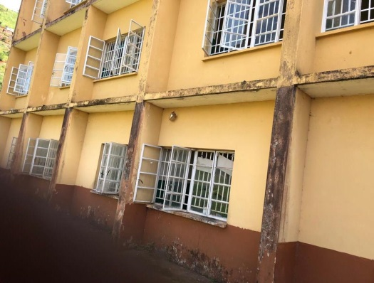
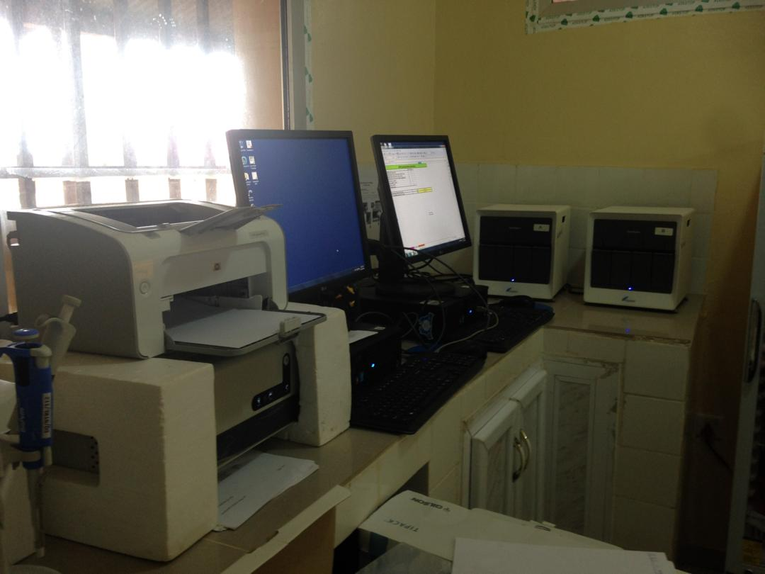
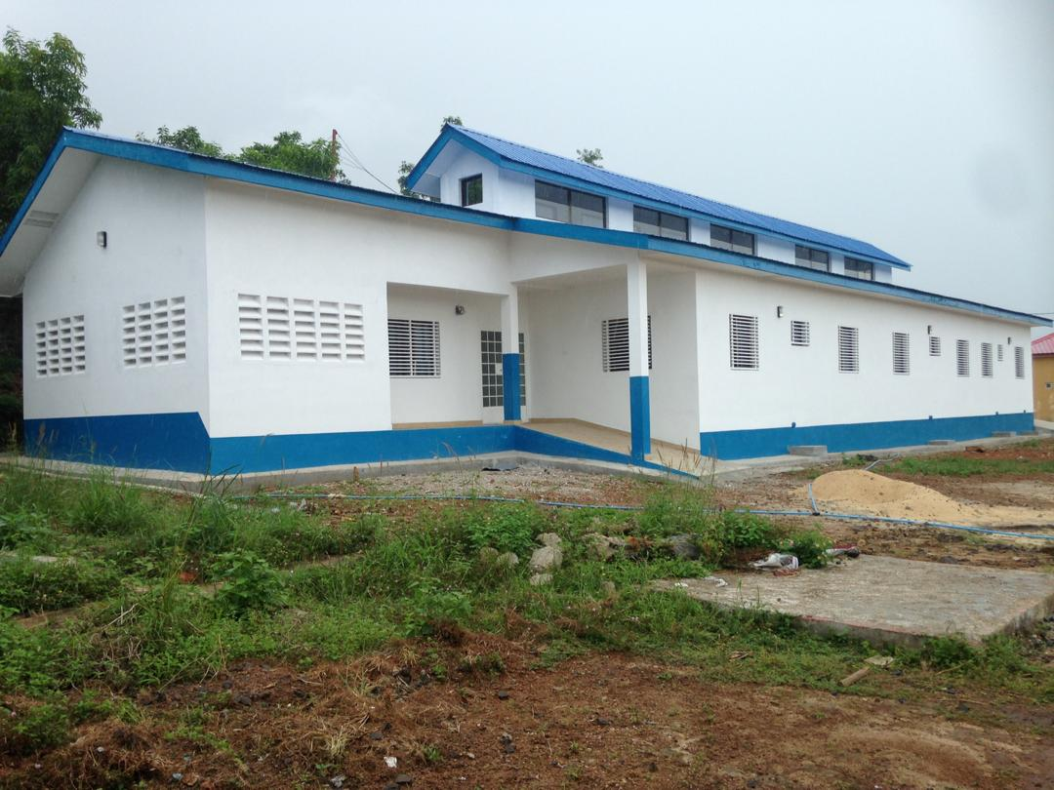
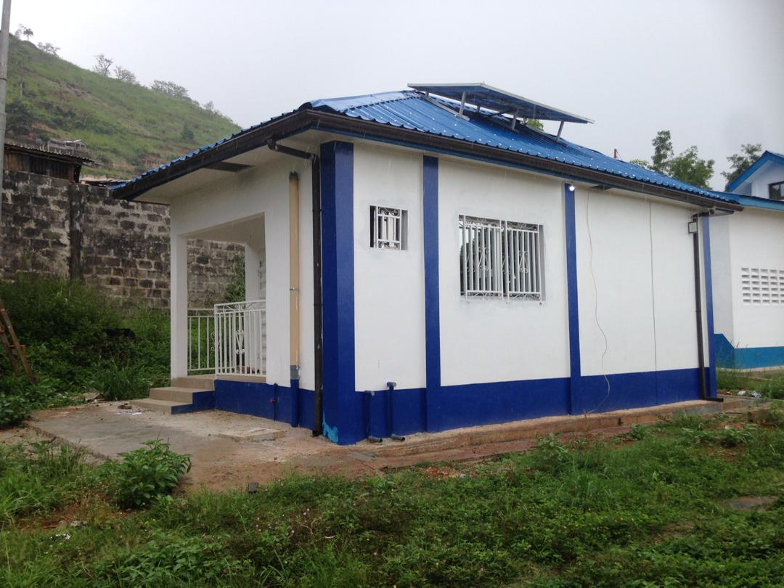
LAKKA
HOSPITAL

Slide 3
Global MDR-TB report
The WHO 2021 report recorded approximately 132,222 cases of rifampicin-resistant TB (RR-TB), from a total of 2.1 million tested.
Between 2018-2022, only 482,683 have been enrolled for treatment; 32% of the targeted 1.5 million cases by 2022.
Globally 150 359 people with MDR/RR-TB were enrolled on treatment in 2020, 15% less from the total of 177 100 in 2019 (Recent gains have been impacted with a drastic fall of 22%)
However, global trends have shown a steady increase in treatment success rates from 50% in 2012 to 59% 2018. The treatment success rate in WHO AFRO region is 69%.

Slide 4
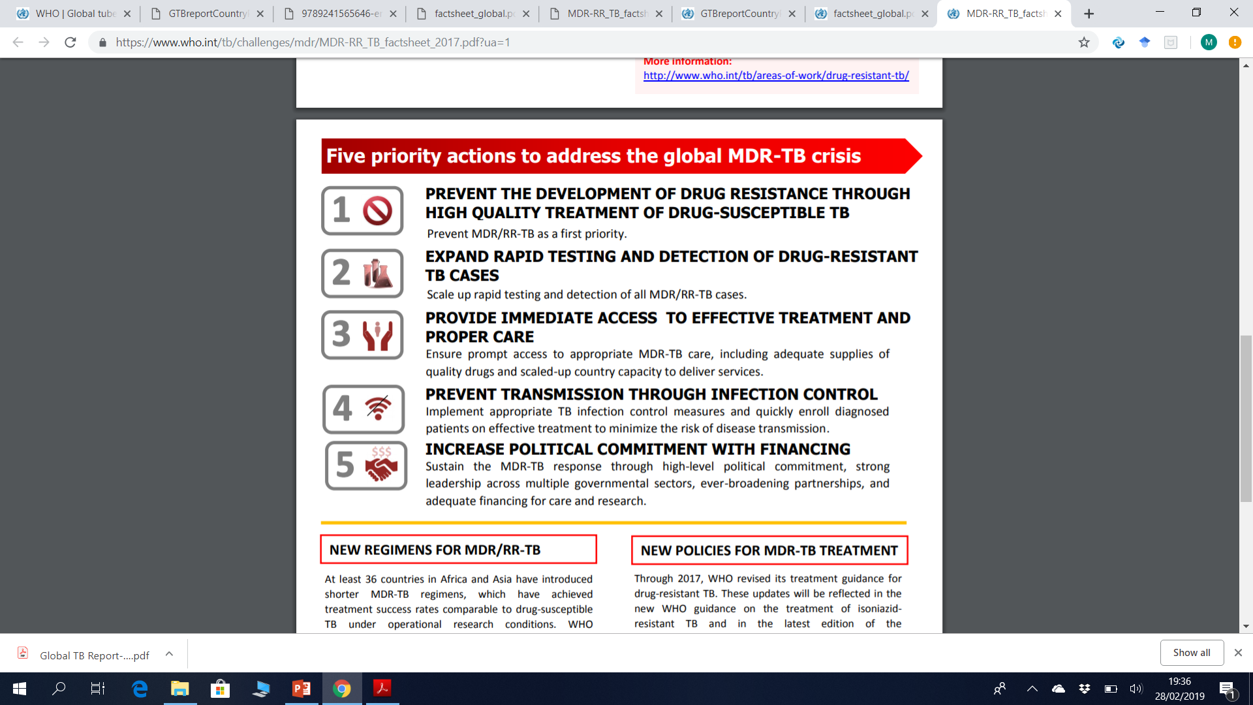
Global actions to address MDR-TB

Slide 5
MDR-TB in Sierra Leone
Among 30 high TB burden countries
Low TB case notification, 2% for MDR-TB
Incidence 8.2/100,000 people
True number MDR-TB cases unknown
Treatment of MDR TB started in 2017 in a 100-bed hospital on the outskirts of Freetown
From April 2017 to September 2019, 370 people were notified with MDR-TB in Sierra Leone
Notes:
True number MDR-TB cases unknown due to limited diagnostics capacity and access to care, and social issues such as stigma and the absence of a prevalence survey

Slide 6
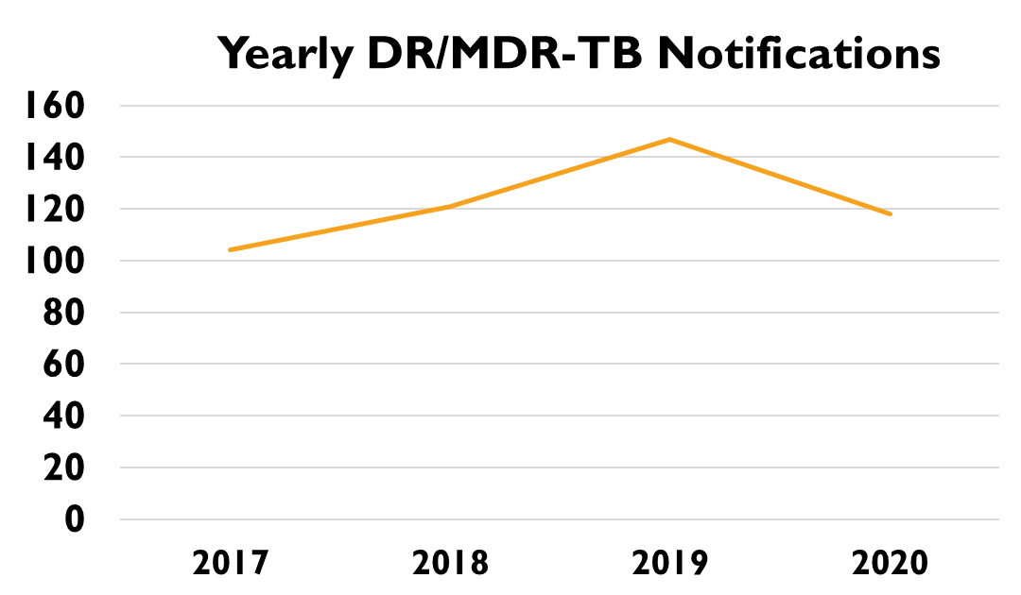
MDR/DR-TB Notifications in Sierra Leone

Slide 7
Programmatic challenges to address MDR-TB in Sierra Leone
Limited knowledge of health staff and communities on MDR-TB
Lack of prompt treatment of drug-sensitive TB and contact tracing
Limited access to rapid diagnostic (point of care) tests and monitoring (DST, LFT etc)
Lack of integrated management of MDR-TB in people with HIV and/or other comorbidities
Need for pharmacovigilance and nationwide roll out of oral regimen
Current centralized model of MDR treatment
Lack of structured social support to improve adherence to and completion of treatment
Constrained human resource for laboratory strengthening and service delivery
Need for scale-up of research to support evidence-based, locally-appropriate policies and actions

Slide 8
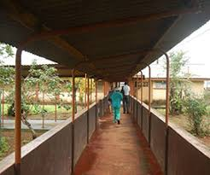
National MDR-TB Cohort Study
AIM: to characterize social and health factors associated with adverse treatment outcomes of people with DR/MDR TB in Sierra Leone
DESIGN: retrospective cohort study
STUDY SETTING: A government hospital that offers free treatment services for patients with TB, HIV and Leprosy
STUDY POPULATION: all patients that met Sierra Leone NTP programmatic criteria for DR/MDR TB treatment and gave consent to participate
SAMPLE SIZE: programmatic opportunistic study with no formal sample size calculations

Slide 9
Patient Categories
PATIENTS CATEGORIES | DEFINITIONS
Category 1 Failure of drug sensitive TB (DS-TB) treatment for new patients | Patients who are positive at 5 months or beyond on category I treatment
Category 2 Failure of DS TB retreatment regimen (these were for patients who had treatment prior to 2017) | Patients who are still positive at 5 months or more of category II treatment
Relapse This could be either due to a true relapse or a reinfection | Recurrent TB infection following a declaration of cure in the most recent treatment course.
Treatment after loss to follow up | Interrupted treatment for two or more consecutive months
New | Never been exposed to TB treatment, but developed MDR TB

Slide 10
Treatment regimens
Regimen | Drugs used in treatment | Eligibility criteria for selecting treatment regimen
Short (9-11 months) | Intensive phase, 4-6 months daily: Kanamycin Clofazimine Moxifloxacin Prothionamide Isoniazid (high dose, 600-1500mg per day) Ethambutol Pyrazinamide Continuation phase, 5 months daily: Moxifloxacin Clofazimine Ethambutol Pyrazinamide | 1. Proven RR- or MDR-TB by microbiological or molecular test 2. Category I: Unsuccessful DS-TB Treatment regimen of new patients 3. Category II: Unsuccessful DS-TB Retreatment regimen 4. No eligibility criteria for long regimen are met

Slide 11
TREATMENT REGIMEN
Regimen | Drugs used in treatment | Eligibility criteria for selecting treatment regimen
Long (18-24 months) | Intensive phase, 8-12 months daily: Kanamycin/Capreomycin Levofloxacin Prothionamide Cycloserine Pyrazinamide Isoniazid Continuation phase, 12 months daily: Levofloxacin Prothionamide | 1. Lack of conversion of sputum culture to negative at month six of short MDR-TB treatment regimen 2. Those previously exposed to second-line drugs or substitutes for second line drugs (e.g. streptomycin) with confirmed DST resistance to these drugs 3. Patients with pre-XDR TB (pre-extensively drug resistant TB, indicating resistance to rifampicin, isoniazid, plus quinolones or injectable agents) or XDR-TB (extensively drug resistant TB, indicating resistance to rifampicin, isoniazid, quinolones, and injectable agents) 4. Patients with extrapulmonary MDR-TB

Slide 12
Regimen | Drugs used in treatment | Eligibility criteria for selecting treatment regimen
Individualized | 1. Injectables switched to bedaquiline 2. Drugs substituted to alternatives with favourable side effect profile within the same WHO A/B/C group | 1. Patients with adverse drug reactions to injectables 2. Patients with adverse reactions to other drugs 3. Patients with resistance to the injectables plus other drugs

Slide 13
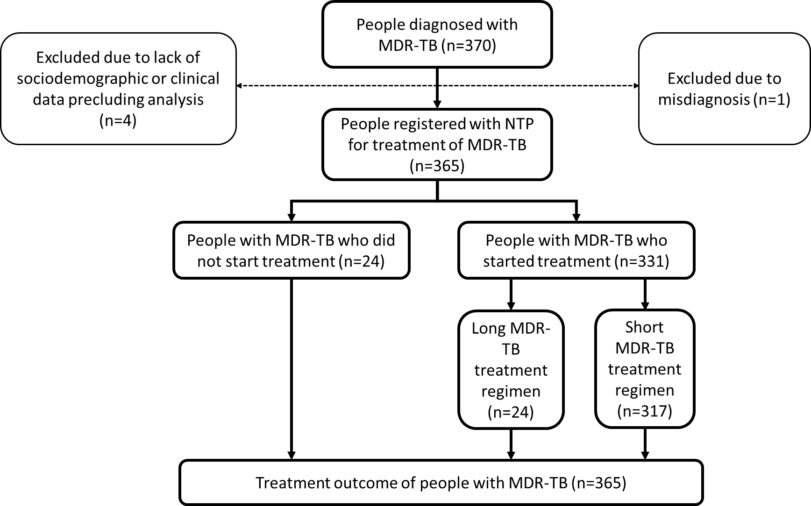
Study flow chart

Slide 14
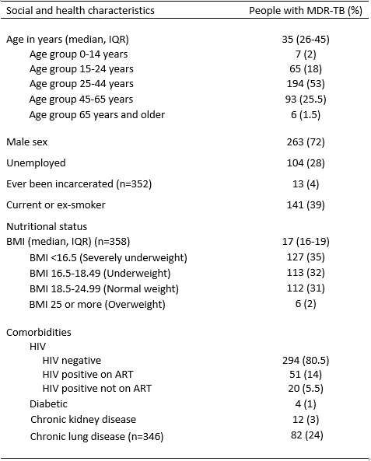
Sociodemographic and clinical characteristics of cohort (n=365)
Median age 35
72% male
67% underweight or
severely underweight
20% HIV positive of
whom 25% not on ART

Slide 15
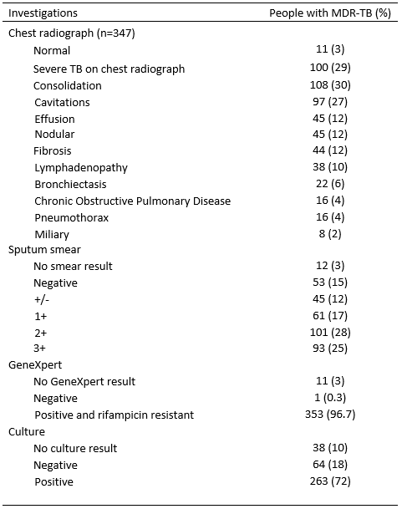
Sociodemographic and clinical characteristics of cohort (n=365)
One third had
cavitation and/or
consolidation
82% smear
positive
Notes:
Severe TB: programmatically defined as

Slide 16
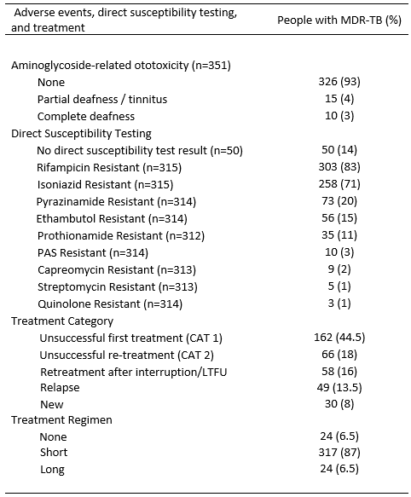
Sociodemographic and clinical characteristics of cohort (n=365)
Half DS-TB first-line
treatment failure
87% received short
aminoglycoside-
containing regimen

Slide 17
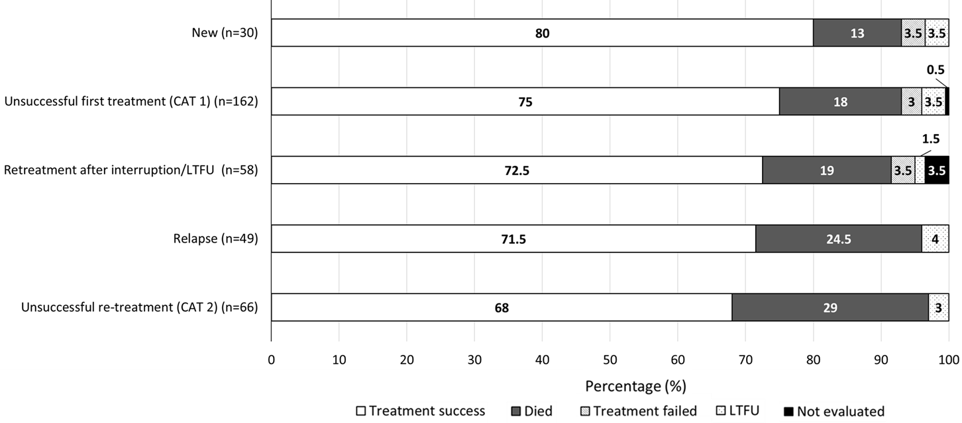
TB treatment outcome of people with MDR-TB by patient category (n=365)
Overall, 267/365 (73%) had MDR-TB treatment success with highest success in new patients

Slide 18
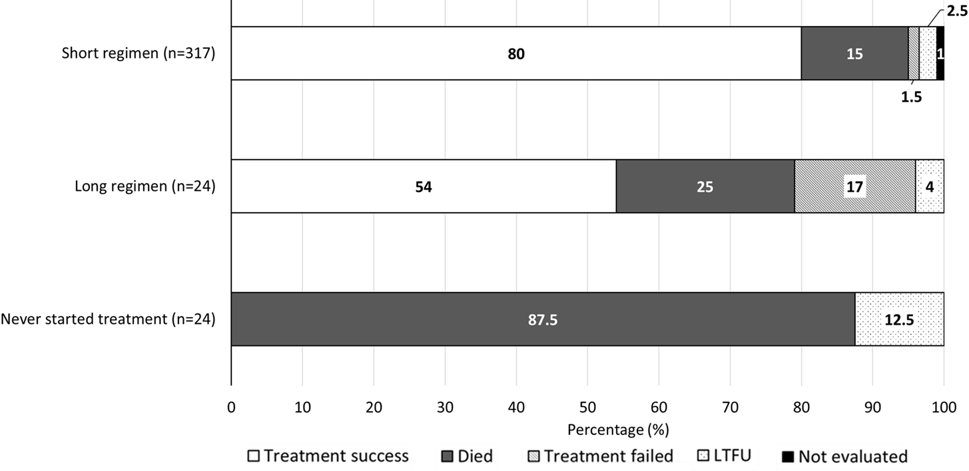
TB treatment outcome of people with MDR-TB by treatment regimen (n=365)
People who received the short treatment regimen had the highest rates of treatment success

Slide 19
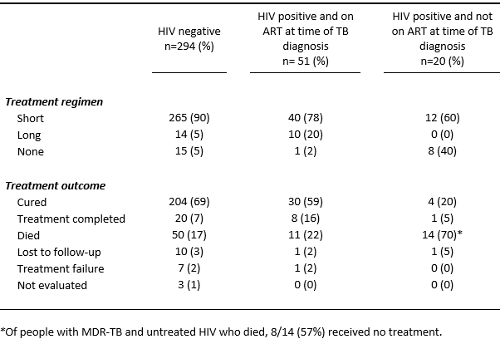
HIV profile, treatment regimen, and treatment outcome (n=362)
Of people with HIV who were not on ART at time of MDR-TB diagnosis (n=20),
70% died and 40% never received MDR-TB treatment

Slide 20
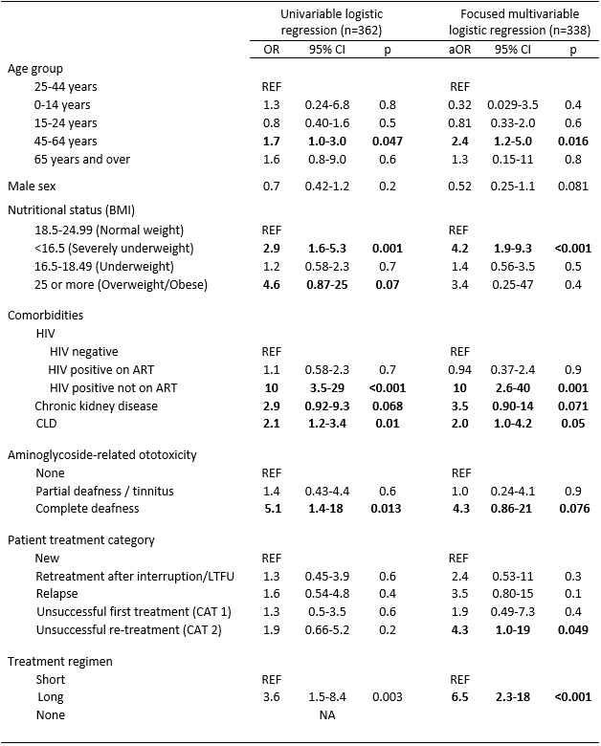
Multiple imputation univariable and multivariable logistic regression of factors associated with adverse MDR-TB treatment outcome (n=362)*
Age 45-64 years old,
severe underweight,
HIV positive and not on ART, chronic lung disease,
previous DS-TB retreatment failure, and
long regimen were independently associated
with adverse MDR-TB treatment outcome
*Variables missing >10% of data points were
not imputed, including DST (15% missing)

Slide 21
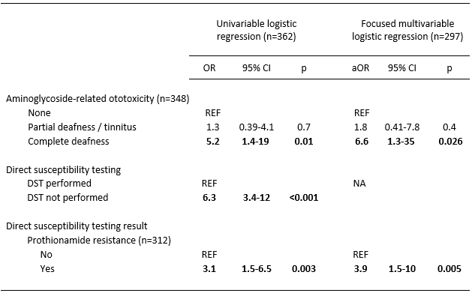
Unimputed univariable and multivariable logistic regression of factors associated with adverse MDR-TB treatment outcome (n=297)*
Additionally, unimputed
regression analyses showed that complete deafness related to aminoglycoside toxicity and resistance to prothionamide were independently associated with adverse MDR-TB treatment outcome
*Only DST and aminoglycoside-related toxicity shown, other variables followed the same pattern of association with adverse MDR-TB treatment outcome identified in the imputed model. Only prothionamide DST resistance result is shown as all other single drug DST results were not associated with adverse MDR-TB treatment outcome.

Slide 22
Conclusions
MDR-TB treatment success rates in Sierra Leone (73%) are comparable to global rates, WHO AFRO region rates (69%), and WHO targets (≥75%).
People treated with short (9-11 month) vs long (18-24 month) regimens had better outcomes, despite both involving injectable aminoglycosides.
Factors associated with adverse MDR-TB treatment outcomes included economically-productive working age (45-64 years), severe underweight, untreated HIV, chronic lung disease, previous unsuccessful drug-sensitive-TB retreatment, and long regimen.
Aminoglycoside-related complete deafness and prothionamide resistance were also independently associated with adverse outcome.
Most (70%) people with MDR-TB and untreated HIV died, 57% of whom never received TB treatment.
Notes:
MDR-TB treatment success rates in Sierra Leone (73%) are comparable to global rates, programmatic rates in other sub-Saharan African countries, and approaching WHO targets (≥75%).
People treated with short (9-11 month) vs long (18-24 month) regimens had better outcomes, despite both involving injectable aminoglycosides.
Factors associated with adverse MDR-TB treatment outcomes included economically-productive, working age (45-64 years), severe underweight, untreated HIV, chronic lung disease, previous unsuccessful drug-sensitive-TB retreatment, and long regimen.
Most (70%) people with MDR-TB and untreated HIV died, 57% of whom never received TB treatment.
Aminoglycoside-related complete deafness and prothionamide resistance were also independently associated with adverse outcome.

Slide 23
Recommendations
Other NTPs, including regionally, could consider replicating this study using programmatic NTP data. Such analyses support evidence-based, locally-appropriate policy and action
Disseminate research findings at district, national, and international level and use findings to inform next iteration of Sierra Leone National MDR-TB Treatment Guidelines
Support advocacy and sensitization of health personnel and communities on TB/MDR-TB
Support finalization and rollout of the scale up plan for rapid diagnostics including network of specimen referral system using both district and national system
Inform, update and implement the Sierra Leone National MDR-TB Treatment Guidelines for people with HIV and/or co-morbidities/malnutrition, and promote pharmacovigilance
Build capacity of health and laboratory personel and support decentralized management
Establish social support system for people with MDR/TB and HIV patients in collaboration with other partners including the private sector

Slide 24
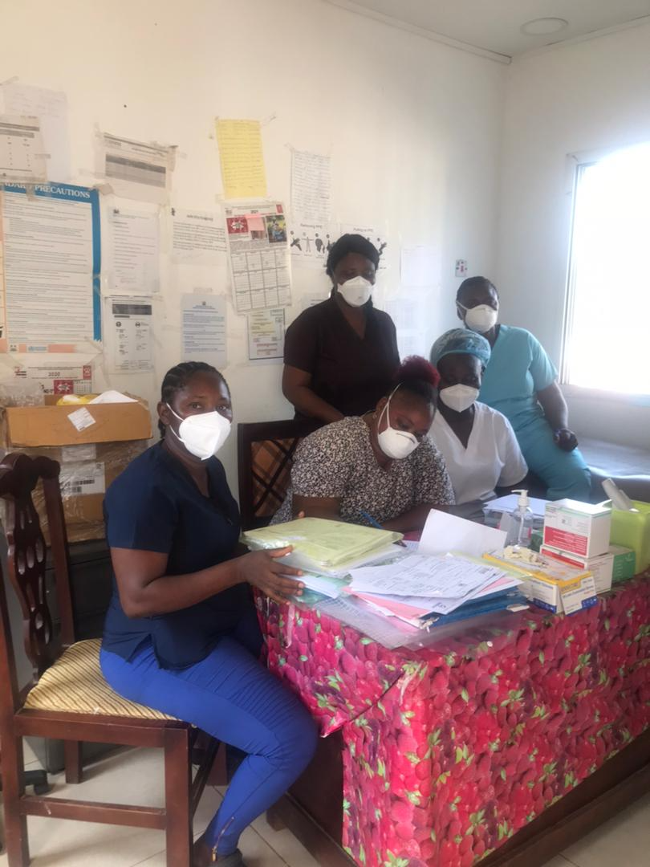
Thanks. Any questions?
Thank you to the people with MDR-TB for their participation in this study and to the healthcare and other professionals who deliver care to people with MDR-TB in Sierra Leone.
Authors
Dr Rashidatu Fouad Kamara
shidakay700@gmail.com / rf.kamara.2018@alumnos.urjc.es
Dr Matthew J Saunders
Dr Foday Sahr
Dr Juan E Losa-Garcia
Dr Lynda Foray
Dr Geraint Davies
Dr Tom Wingfield tom.wingfield@lstmed.ac.uk
Look out for the Lancet Global Health article and
accompanying podcast interview in April 2022!
Staff Of Lakka Hospital

